Slide 1


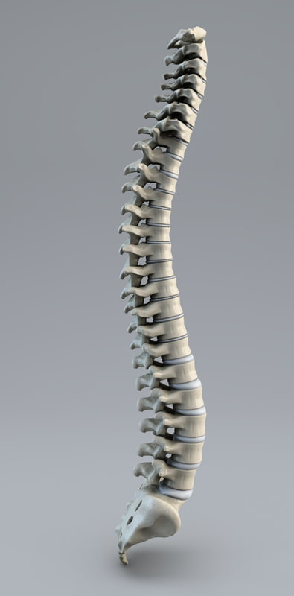
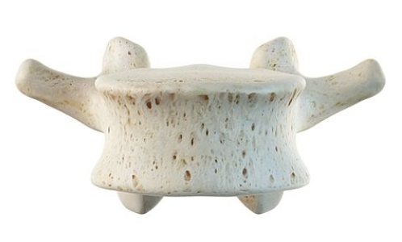
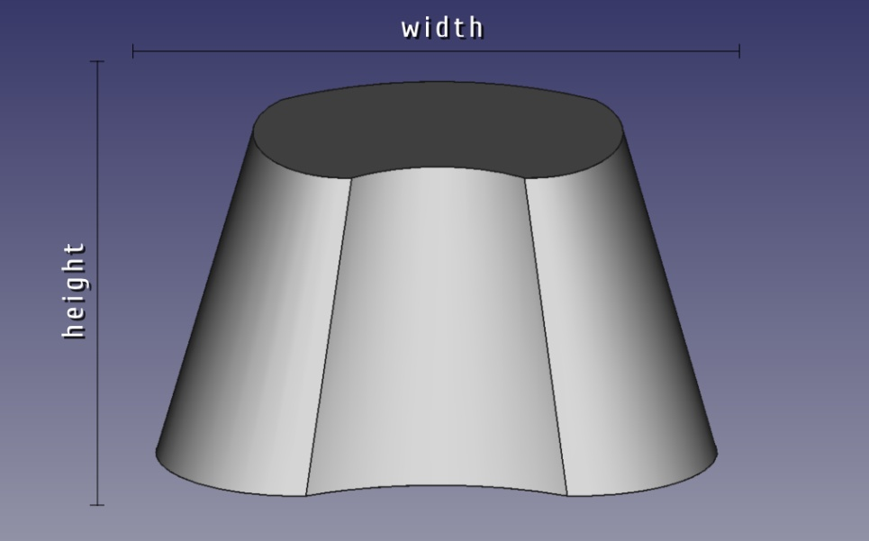
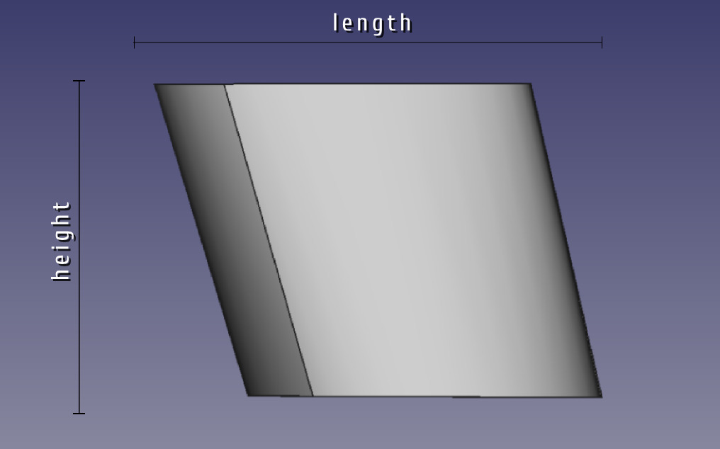
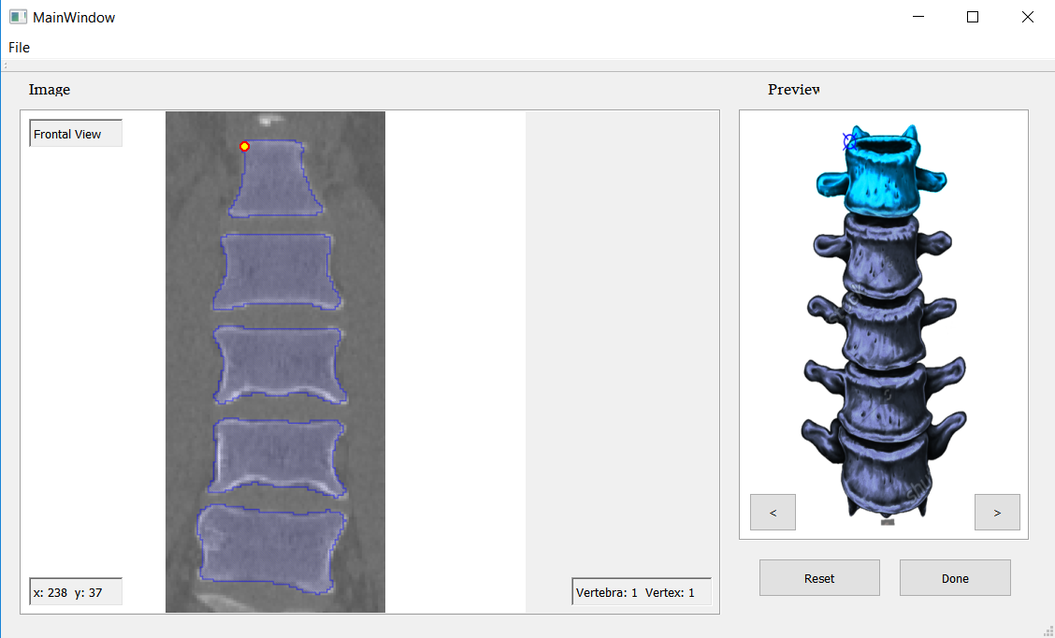
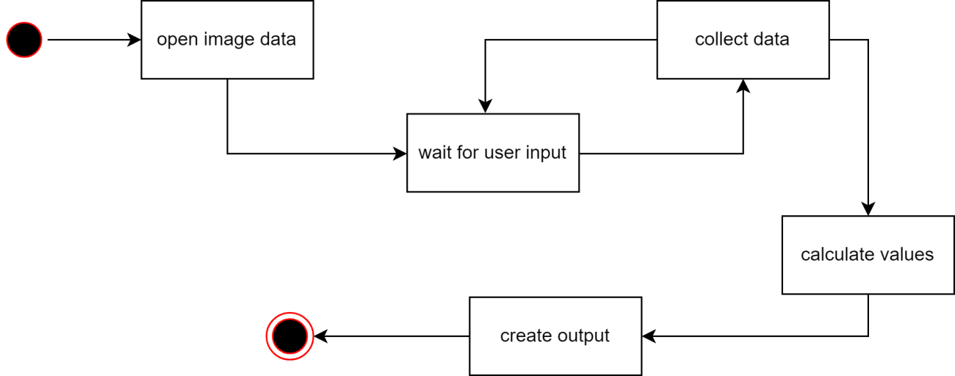
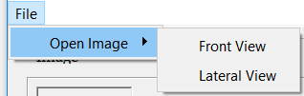
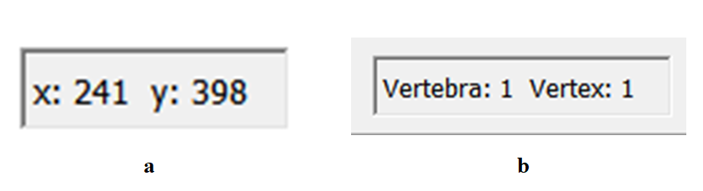
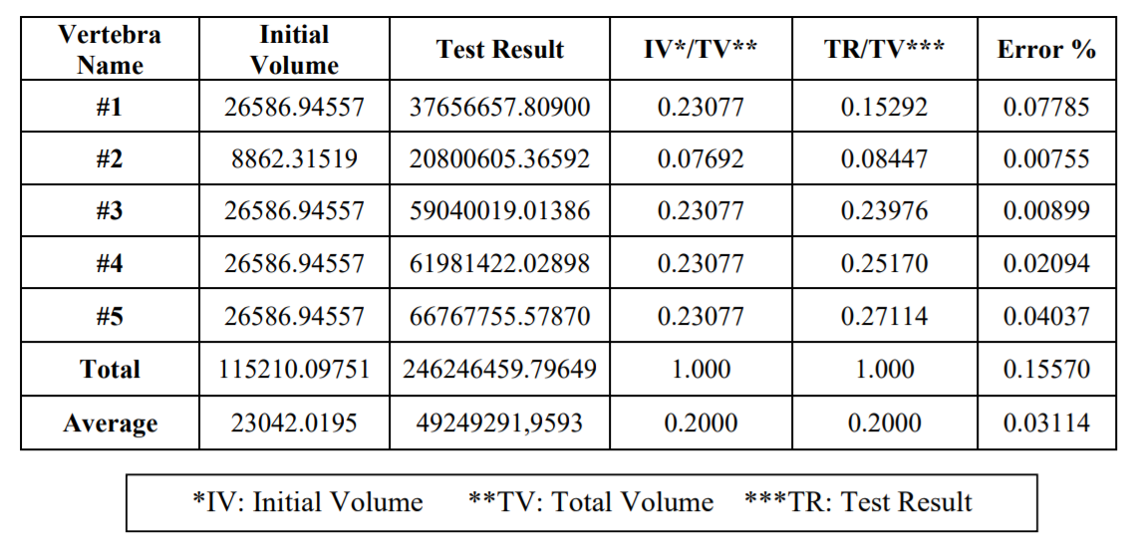
CONSTRUCTING A 3D MODEL
BY USING 2D PARAMETER INPUTS
Umut Naderi Dionysis Goularas
Department of Computer Engineering, Yeditepe University
Abstract
  The main goal is simulating the construction of the lumbar vertebrae in a 3D model. Every distinct individual has different pattern of spine form in terms of lumbar vertebral formation. In our project we have five different shapes, each representing a single vertebra in a lumbar vertebral column consisting five vertebrae. Given two different views from two different coordinate planes, these being frontal view and lateral view, which in our case we take the right view, user is expected to provide the coordinates of the specific vertices in a given sequence of guiding images. Having stored four different x and y coordinate values of vertices for each vertebrae in the first view, user is expected to the the same process for the second view.
  In the final process, by the data obtained by the selections of the user, height, width, length and rotation is calculated by certain formulas. Placement of each vertebrae is determined by the values obtained and each are created by a Python macro, written into a “.py” file to be executed by FreeCAD program, providing us the 3D environment to simulate the lumbar vertebrae formation. Python macro consists of calls to preset 3D renders of vertebrae and their formation. Those commands are modified with the coordinate information provided by the user in the previous steps. Five vertebrae shapes are created according to those information and placed into the 3D environment.
Introduction
One of the most popular methods of studying the spine is transferring it to a three dimensional environment. This 3D environment provides us some benefits for analyzing and altering certain aspects of the objects and models. Vertebra arrangement may have differences on different bodies. Not every individual has the same exact spine formation. Although they may have a similar type, some minor differences will conceive a completely different model than the others. As a matter of fact, these differences should be taken into account when the data are collected. In this project, the lumbar vertebrae information will be given from two images, which are representing two dimensions of view. These views will be from frontal dimension and lateral dimension, which in our case is the right view to be used.
User Interface
Activity State Diagram
Future Work
Improvements can be made on the model representing the vertebra. A realistic model can be taken into account in the future works. This could benefit the research in certain situations such as resemblance. A realistic model also will be good to observe more aspects from object.
Secondly, accuracy can be improved. In our research we took 4 points for each vertebra, this value can be increased. Obtaining more points will increase the accuracy.
Thirdly, the view angles can be increased. In our research we developed our application to handle two different view angles. However, if obtained, a third angle of view can be useful and also will give the opportunity to calculate the rotations of the axis-z in some situations.
All these will help to improve the quality of the research for the future works.
Our Approach
Our main aim is to acquire a proper 3D model of lumbar vertebrae assembled by a data set, initially determined by the user input. Given the images of lumbar vertebrae, it consists of five separate elements in a structure of formation. After understanding the basic form of parametric modeling, we need to create our own model and gather its parameters those which are modified by the user input. We should keep the data for height, width and length of an element, as well as their rotational data.
Parametric Modeling
Parametric modeling is modeling the objects with real-life behaviors and attributes by using modeling software. The important thing in parametric modeling is to simulate the characteristics of the components in the model. The interaction between the objects in a model has a very important role in parametric modeling. Parametric models are created by using mathematical calculations.
References
Kurutz, Marta. "Finite Element Modeling of the Human Lumbar Spine." Finite Element Modeling of the Human Lumbar Spine (2010).
MH, Pope. "Biomechanics of the lumbar spine." Annals of medicine (1989).
Panjabi M, White A. "Physical properties and functional biomechanics of the spine." Clinical biomechanics of the spine (1990).
Results
Contact
goularas@cse.yeditepe.edu.tr
naderiumut@gmail.com

